Slide 1
Chapter 5: CPU Scheduling

Slide 2
Operating System Examples
Linux scheduling
Windows scheduling
Solaris scheduling

Slide 3
Linux Scheduling Through Version 2.5
Prior to kernel version 2.5, ran variation of standard UNIX scheduling algorithm
Version 2.5 moved to constant order O(1) scheduling time
  Preemptive, priority based
  Two priority ranges: time-sharing and real-time
  Real-time range from 0 to 99 and nice value from 100 to 140
  Map into global priority with numerically lower values indicating higher priority
  Higher priority gets larger q
  Task run-able as long as time left in time slice (active)
  If no time left (expired), not run-able until all other tasks use their slices
  All run-able tasks tracked in per-CPU runqueue data structure
    Two priority arrays (active, expired)
    Tasks indexed by priority
    When no more active, arrays are exchanged
  Worked well, but poor response times for interactive processes
Kaynak : https://docs.kernel.org/scheduler/index.html
Notes:
preamble:
O (1) scheduler - in short, the scheduler policy was quite simple: each cpu had 2 queues: in one there are tasks that will be launched soon, in the other - sleeping tasks. when the first stage turned out to be empty, it changed places with the second, respectively, in the second stage, all sleeping processes “woke up”, and in the first it served as a queue for exhausted and asleep processes. therefore, the running time of the algorithm, firstly, does not depend on the class of processes, and secondly, it is constant - O (1).

Slide 4
Linux Scheduling in Version 2.6.23 +
Completely Fair Scheduler (CFS)
Linux 2.6.23
Developed by Ingo Molnar
Scheduling classes
  Each has specific priority
  Scheduler picks highest priority task in highest scheduling class
  Rather than quantum based on fixed time allotments, based on proportion of CPU time
  2 scheduling classes included, others can be added
    default
    real-time
Kaynak : https://docs.kernel.org/scheduler/index.html
Notes:
Completely Fair Scheduler - uses a red-black tree to store processes , where the key is the wait_runtime of each process. wait_runtime is the number of nanoseconds that a given process has failed or reworked. those. if it is <0, then it processed, if it> 0, then it is underworked. this measure allows you to detect out-of-ballance from the 'ideal case'. depending on the value of wait_runtime, the process takes its place in the tree. if wait_runtime <0, then, I believe, the process will sit at the lower levels, if greater than 0, then closer to the top. therefore, CFS is not an O (1) scheduler , it is O (logN).

Slide 5
Linux Scheduling in Version 2.6.23 +
Quantum calculated based on nice value from -20 to +19
  Lower value is higher priority
  Calculates target latency – interval of time during which task should run at least once
  Target latency can increase if say number of active tasks increases
CFS scheduler maintains per task virtual run time in variable vruntime
  Associated with decay factor based on priority of task – lower priority is higher decay rate
  Normal default priority yields virtual run time = actual run time
To decide next task to run, scheduler picks task with lowest virtual run time
Kaynak : https://docs.kernel.org/scheduler/index.html
Notes:
https://slideplayer.com/slide/6578491/
No time slice, no sleep time tracking, no process type
Vruntime kullanılmakta
Uses Red Black Tree store, sort and schedule task
O(logn)

Slide 6

CFS Performance

Slide 7
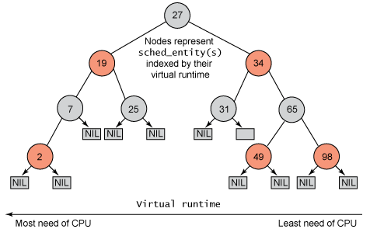
Red-Black Tree
https://www.quora.com/Why-does-the-Linux-Completely-Fair-Scheduler-use-a-red-black-tree-instead-of-the-simpler-array-with-queues
Notes:
The main advantage of Red-Black trees is that a single top-down pass may be used in both insertions and deletions.
Red–black trees offer worst-case guarantees for insertion time, deletion time, and search time.
Every path from root to leaf has same length. Every node has at most 2 children.
If the maximum leaf nodes is reached, new items cause a shifting/rotation of the root to restore the path length.
If , say 16 was inserted, it would be placed as the right child of 7, same hieght as 2.
Then if 18 was inserted, it would go on the right child of 16 and a reordering would take place to maintain the height. 16 would move up to where 19 is and 19 would move down to the left child of 25. So 16 would have 7 on the left and 18 on the right and the height ( and search time) would be the same for all leaves.
The space needed for a the tree is (𝑛).O(n).
Search is in (log𝑛)O(log⁡n) time.
Insert is in (log𝑛)O(log⁡n) time.
Delete is in (log𝑛)O(log⁡n) time.

Slide 8
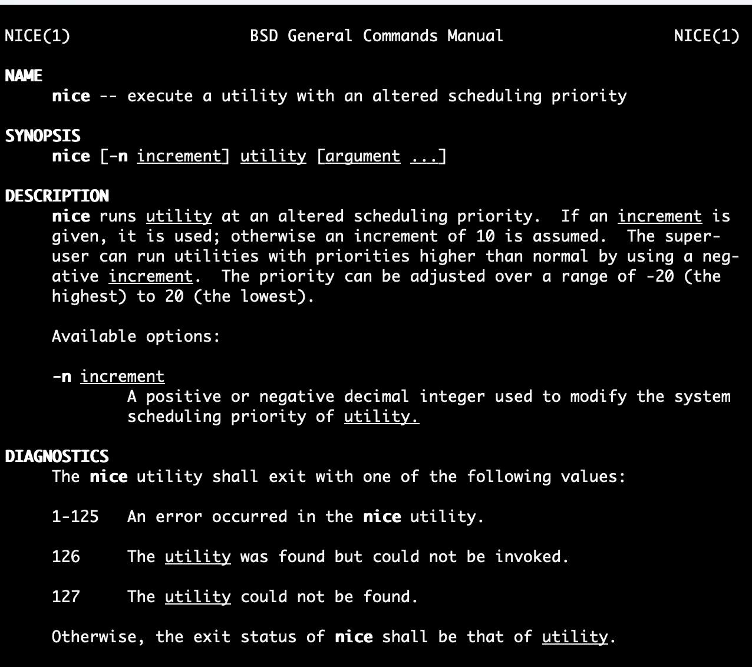

Slide 9

Linux Scheduling (Cont.)
Real-time scheduling according to POSIX.1b
  Real-time tasks have static priorities
Real-time plus normal map into global priority scheme
Nice value of -20 maps to global priority 100
Nice value of +19 maps to priority 139

Slide 10
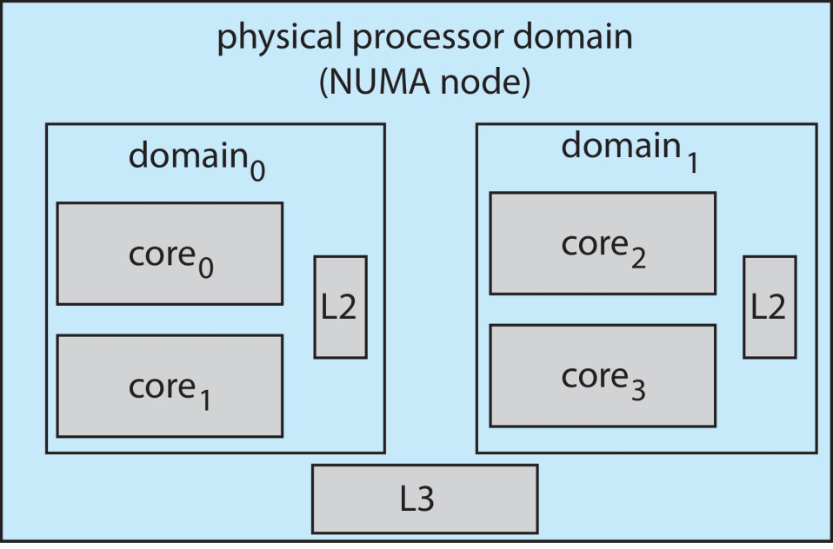
Linux Scheduling (Cont.)
Linux supports load balancing, but is also NUMA-aware.
Scheduling domain is a set of CPU cores that can be balanced against one another.
Domains are organized by what they share (i.e. cache memory.) Goal is to keep threads from migrating between domains.

Slide 11
Windows Scheduling
Windows uses priority-based preemptive scheduling
Highest-priority thread runs next
Dispatcher is scheduler
Thread runs until (1) blocks, (2) uses time slice, (3) preempted by higher-priority thread
Real-time threads can preempt non-real-time
32-level priority scheme
Variable class is 1-15, real-time class is 16-31
Priority 0 is memory-management thread
Queue for each priority
If no run-able thread, runs idle thread

Slide 12
Windows Priority Classes
Win32 API identifies several priority classes to which a process can belong
  REALTIME_PRIORITY_CLASS, HIGH_PRIORITY_CLASS, ABOVE_NORMAL_PRIORITY_CLASS,NORMAL_PRIORITY_CLASS, BELOW_NORMAL_PRIORITY_CLASS, IDLE_PRIORITY_CLASS
  All are variable except REALTIME
A thread within a given priority class has a relative priority
  TIME_CRITICAL, HIGHEST, ABOVE_NORMAL, NORMAL, BELOW_NORMAL, LOWEST, IDLE
Priority class and relative priority combine to give numeric priority
Base priority is NORMAL within the class
If quantum expires, priority lowered, but never below base

Slide 13
Windows Priority Classes (Cont.)
If wait occurs, priority boosted depending on what was waited for
Foreground window given 3x priority boost
Windows 7 added user-mode scheduling (UMS)
  Applications create and manage threads independent of kernel
  For large number of threads, much more efficient
  UMS schedulers come from programming language libraries like C++ Concurrent Runtime (ConcRT) framework

Slide 14
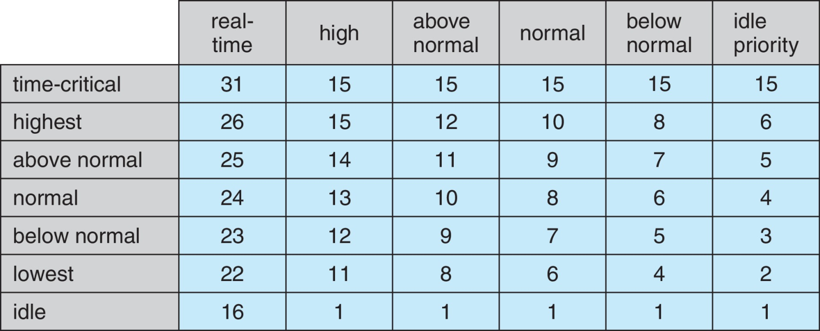
Windows Priorities

Slide 15
Solaris
Priority-based scheduling
Six classes available
  Time sharing (default) (TS)
  Interactive (IA)
  Real time (RT)
  System (SYS)
  Fair Share (FSS)
  Fixed priority (FP)
Given thread can be in one class at a time
Each class has its own scheduling algorithm
Time sharing is multi-level feedback queue
  Loadable table configurable by sysadmin

Slide 16
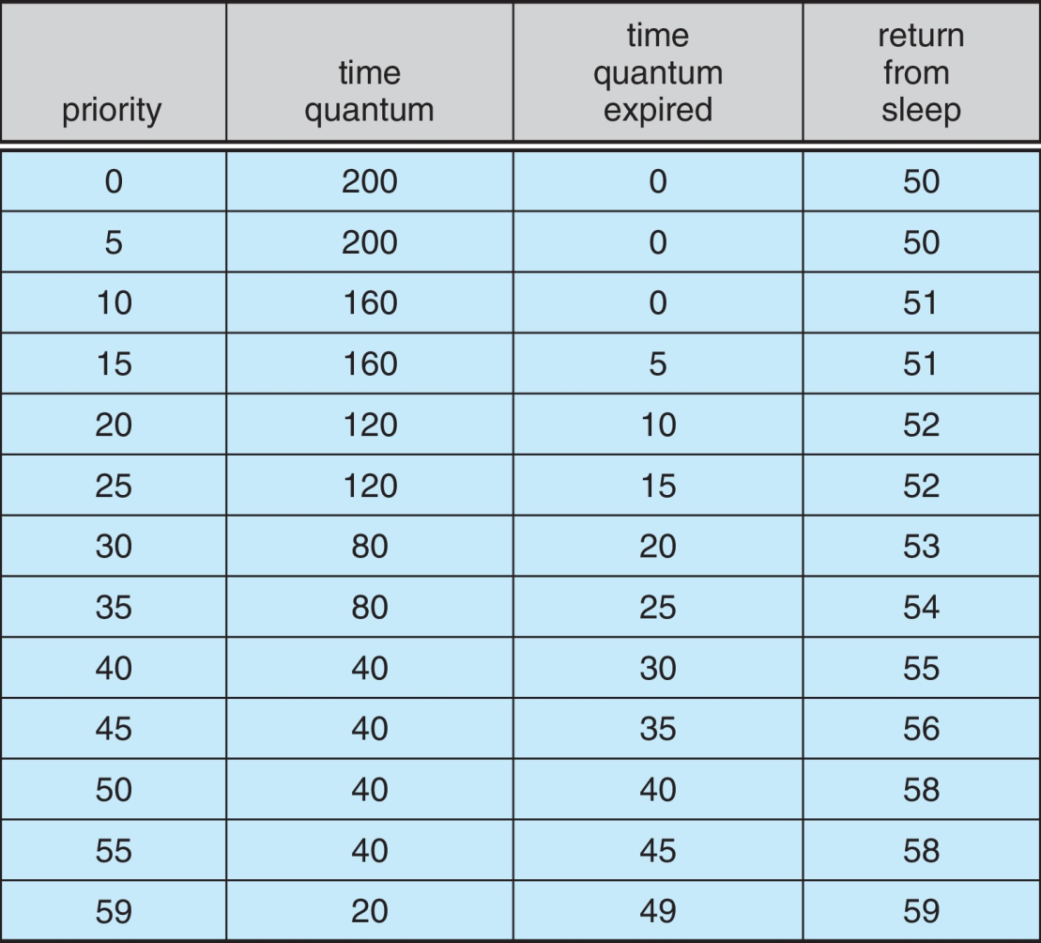
Solaris Dispatch Table

Slide 17
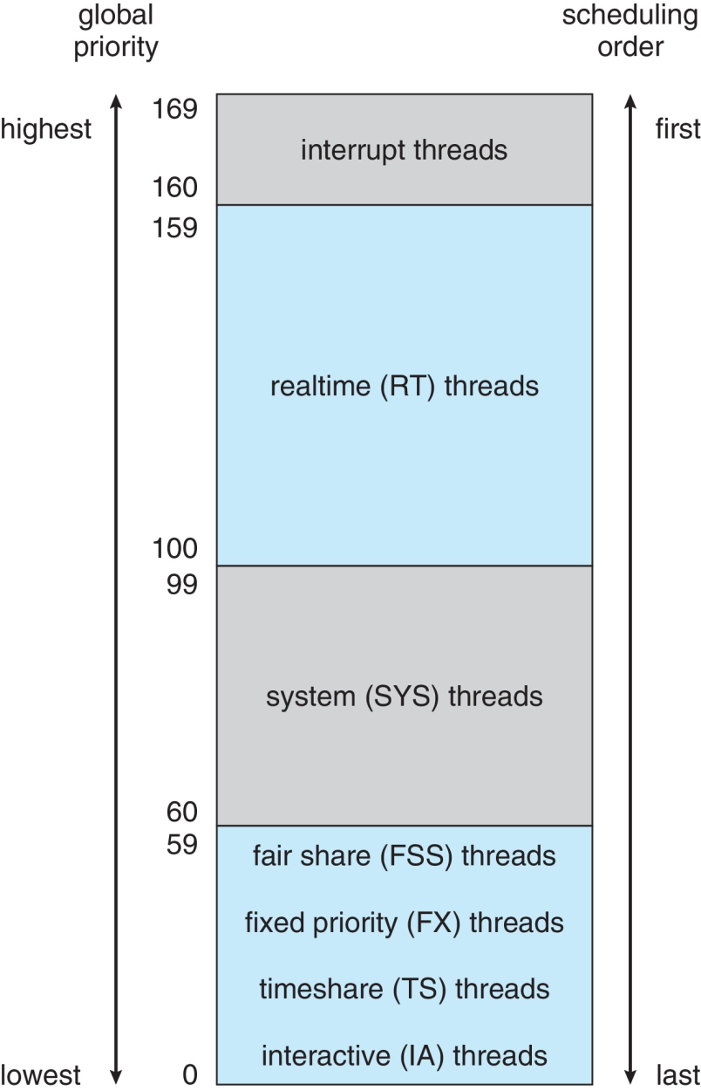
Solaris Scheduling

Slide 18
Solaris Scheduling (Cont.)
Scheduler converts class-specific priorities into a per-thread global priority
  Thread with highest priority runs next
  Runs until (1) blocks, (2) uses time slice, (3) preempted by higher-priority thread
  Multiple threads at same priority selected via RR

Slide 19

Algorithm Evaluation
How to select CPU-scheduling algorithm for an OS?
Determine criteria, then evaluate algorithms
Deterministic modeling
  Type of analytic evaluation
  Takes a particular predetermined workload and defines the performance of each algorithm for that workload
Consider 5 processes arriving at time 0:

Slide 20



Deterministic Evaluation
For each algorithm, calculate minimum average waiting time
Simple and fast, but requires exact numbers for input, applies only to those inputs
  FCS is 28ms:
  Non-preemptive SFJ is 13ms:
  RR is 23ms:

Slide 21
Queueing Models
Describes the arrival of processes, and CPU and I/O bursts probabilistically
  Commonly exponential, and described by mean
  Computes average throughput, utilization, waiting time, etc
Computer system described as network of servers, each with queue of waiting processes
  Knowing arrival rates and service rates
  Computes utilization, average queue length, average wait time, etc

Slide 22
Little’s Formula
n = average queue length
W = average waiting time in queue
λ = average arrival rate into queue
Little’s law – in steady state, processes leaving queue must equal processes arriving, thus:
n = λ x W
  Valid for any scheduling algorithm and arrival distribution
For example, if on average 7 processes arrive per second, and normally 14 processes in queue, then average wait time per process = 2 seconds

Slide 23
Simulations
Queueing models limited
Simulations more accurate
  Programmed model of computer system
  Clock is a variable
  Gather statistics indicating algorithm performance
  Data to drive simulation gathered via
    Random number generator according to probabilities
    Distributions defined mathematically or empirically
    Trace tapes record sequences of real events in real systems

Slide 24
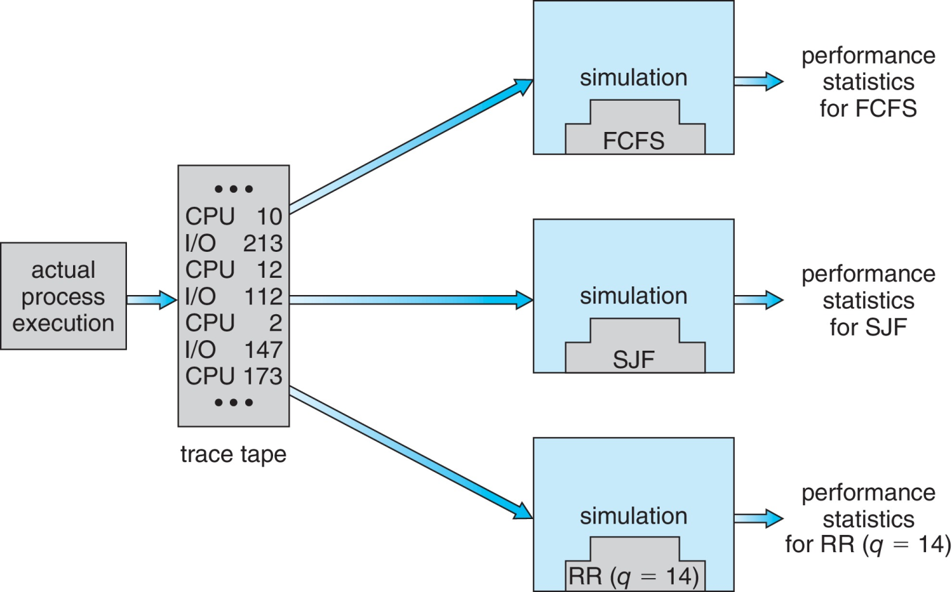
Evaluation of CPU Schedulers by Simulation

Slide 25
Implementation
Even simulations have limited accuracy
Just implement new scheduler and test in real systems
  High cost, high risk
  Environments vary
Most flexible schedulers can be modified per-site or per-system
Or APIs to modify priorities
But again environments vary

Slide 26
End of Chapter 5

